Slide 1
MY CAPSTONE PROJECT-
Integrated Electrical Maintainence Equipment Analysis (2018-2021)

Slide 2
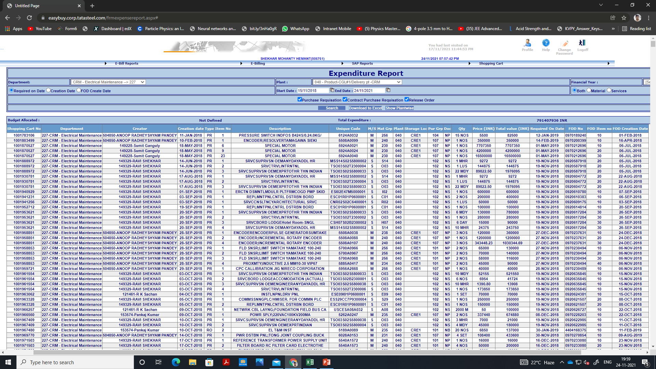
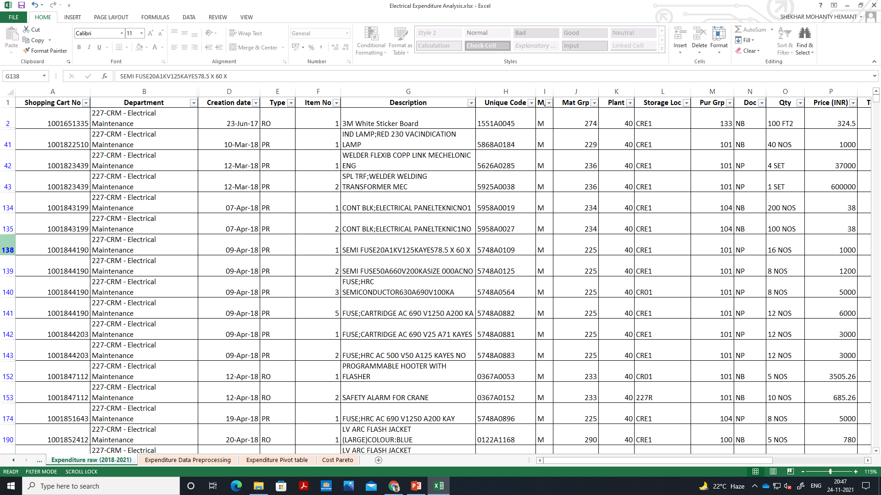
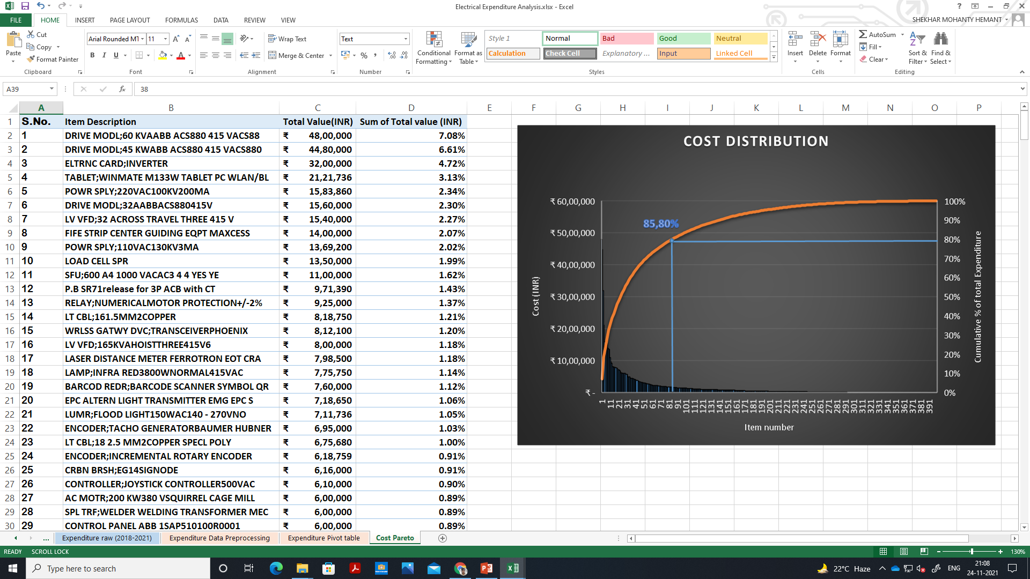
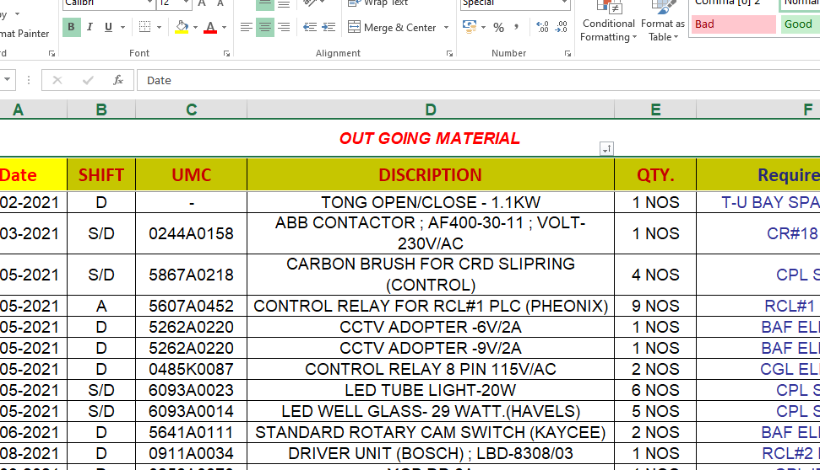
Data- Collection

